Slide 1


Slide 2

Marios Michailidis

Slide 3


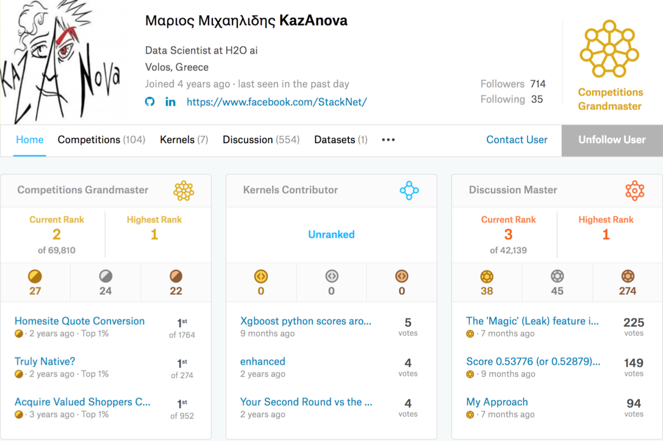
Background
Research data scientist at
PhD in ensemble methods
Former kaggle #1

Slide 4
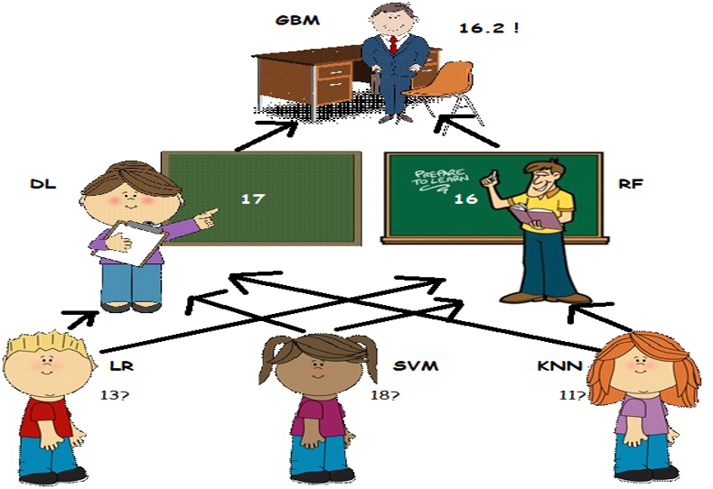
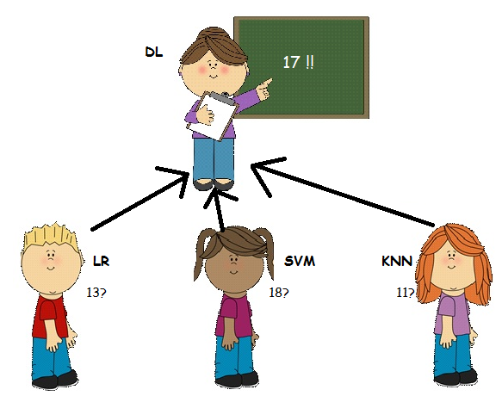
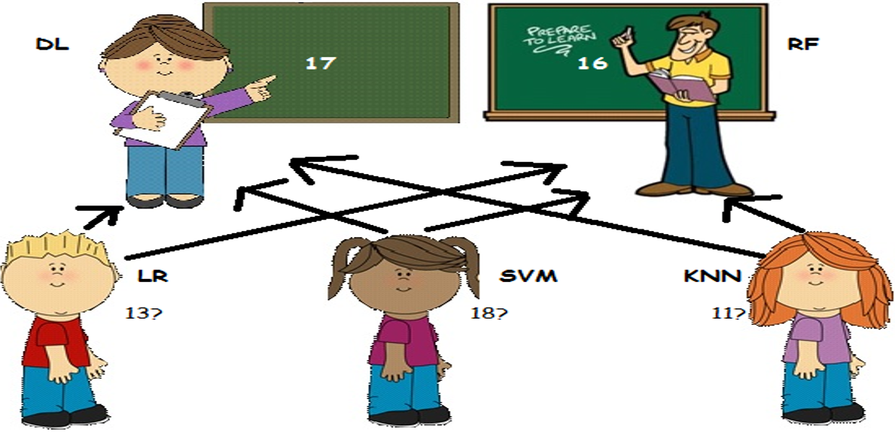
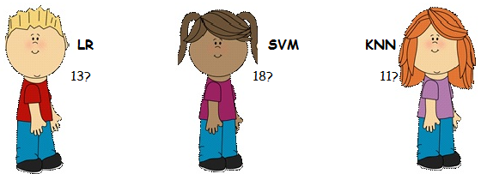
Multi meta modelling naïve explanation

Slide 5
Methodology
Wolpert in 1992 introduced stacking. It involves:
Splitting the train set into two disjoint sets.
Train several base learners on the first part.
Make predictions with the base learners on the second (validation) part.
Using the predictions from (3) as the inputs to train a higher level learner.

Slide 6

Still confused about Stacking?
Train algorithm 0 on A and make predictions for B and C and save to B1, C1
Train algorithm 1 on A and make predictions for B and C and save to B1, C1
Train algorithm 2 on A and make predictions for B and C and save to B1, C1
Consider datasets A,B,C. Target variable (y) is known for A,B
Train algorithm 3 on B1 and make predictions for C1

Slide 7
How to do Multi-level stacking competitively
K=4
Fold : 1
Fold : 2
Fold : 3
Fold : 4
Predict
Mini train
Mini valid
Train
Training data
Train data
Valid data

Slide 8
Maximize gain from stacking with…
Diversity based on algorithms:
2-3 gradient boosted trees
2-3 Neural nets
1-2 ExtraTrees/Random Forest
1-2 linear models as in logistic/ridge regression, linear svm
1 knn model
1 Factorization machine (libfm)
Diversity based on input data:
Categorical features: One hot, label encoding, target encoding, frequency
Numerical features: outliers, binning, derivatives, percentiles, scaling
Interactions : col1*/+-col2, groupby, unsupervised

Slide 9
Autokazanova42
GBM_1
DL_1
FM_1
KNN_1
LIN_1
RF_1
model_x
model_z
model_y
……
GBM
Random Forest
DL
KNN
FM
Linear Regression
…and more
Tuning + Feature Engineering+
Feature Selection
Scaling
Target Encoding
Tuning + Feature Selection
DL
Random Forest
GBM
Linear Regression
FM
Tuning
KNN
Binning
Frequency
Target Encoding
Onehot
Frequency
Binning
Onehot
Binning
Scaling
Onehot
Frequency
Target Encoding
Label encoding
Scaling
Binning
…and more

Slide 10

What is StackNet
A scalable meta modelling methodology that utilizes stacking to combine multiple models in a neural network architecture of multiple levels.

Slide 11
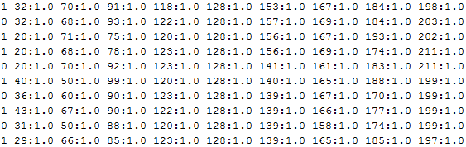
Command Line parameters
Input data
Command | Explanation
sparse | True if the data to be imported are in sparse format (libsvm)
has_head | True if train_file and test_file have headers else false
model | Name of the output model file.
pred_file | Name of the output prediction file.
train_file | Name of the training file.
test_file | Name of the test file.
test_target | True if the test file has a target variable in the beginning
params | Parameter file where each line is a model.
verbose | True if we need StackNet to output its progress else false
threads | Number of models to run in parallel.
metric | Logloss, Rmse, accuracy or auc (for binary only)
stackdata | True for restacking else false
seed | Integer for randomised procedures
folds | Number of folds for re-usable kfold
Java –jar stacknet.jar
train task=classification
sparse=false
model=model.mod
pred_file=pred.csv
train_file=sample_train.csv
test_file=sample_test.csv
params=params.txt
verbose=true
threads=3
metric=logloss
Target variable
Sample Parameter’s File
LogisticRegression Type:Liblinear C:2.0 threads:1 usescale:True
GradientBoostingForestClassifier estimators:300 shrinkage:0.10 max_depth:6 max_features:0.5
RandomForestClassifier estimators:300 threads:5 max_depth:16 max_features:0.25
RandomForestClassifier estimators:1500 max_depth:7 max_features:0.2 min_leaf:1.0

Slide 12
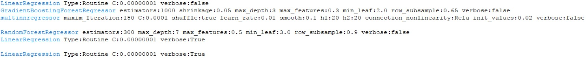
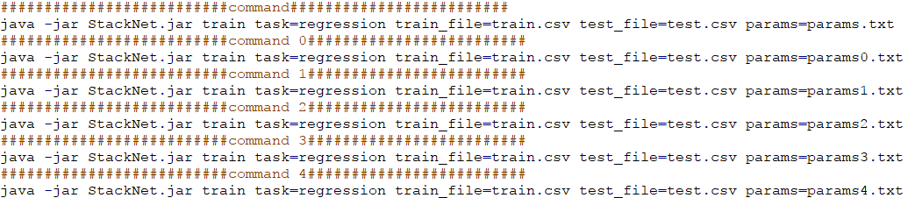
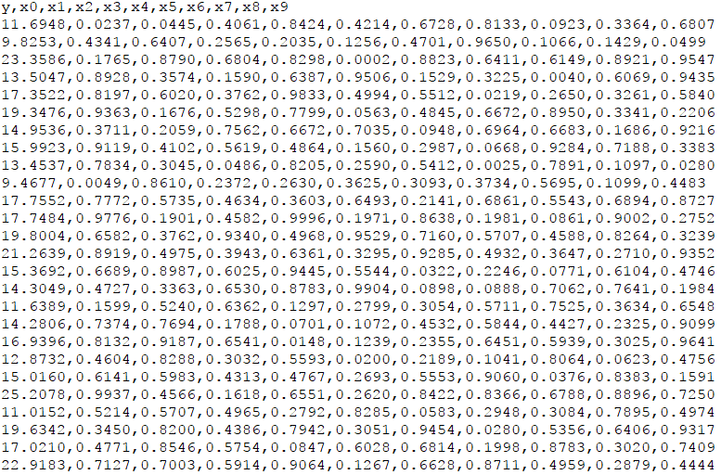
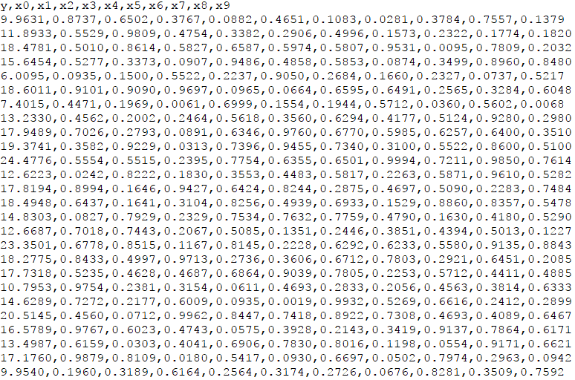
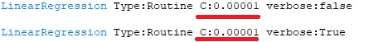
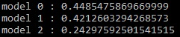
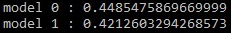
Example
params4.txt
params3.txt
params2.txt
Train.csv
Test.csv
Commands.txt
params1.txt
params.txt
params0.txt
java -jar StackNet.jar train task=regression train_file=train.csv test_file=test.csv params=params.txt pred_file=pred.csv test_target=true has_head=true verbose=true Threads=3 folds=4 metric=rmse
0.242
0.242
0.242
MLP
0.446
4.3
0.162
0.448
0.174
15.4
0.330
0.448
0.162
0.448
0.448
0.448
0.157
LinearRegression
LinearRegression
RandomForest
0.421
LinearRegression
0.421
0.421
0.174
0.421
GBM
LinearRegression

Slide 13
Useful links
Driverless AI: https://www.h2o.ai/driverless-ai/
Get Competitive with Driverless AI: https://www.youtube.com/watch?v=qtUNyJlAID0
Get Competitive with Driverless AI code: https://github.com/kaz-Anova/Competitive_Dai
StackNet: https://github.com/kaz-Anova/StackNet
StackNet Example for H2O World: https://github.com/kaz-Anova/StackNet/blob/master/example/H2OWorld_StackNet_Example/EXAMPLE.MD

Slide 14


